Slide 2
The Rose Orchestra: Mission and Vision
Our Vision:
By 2025, the Rose Orchestra will be embraced as a cultural hub by the entire community.
We will achieve this by:
Broadening our connections with the community,
Empowering our artistic expression, and
Investing in our organizational stability.
Our Mission:
The Rose Orchestra Brampton is a multi-generational organization that brings our community together through the emotional power of live orchestral music.
Notes:
2023 marks 35 years in Brampton of symphony orchestra – a legacy footprint

Slide 3
Meet the Rose Orchestra

Slide 4
Maestro Samuel Tak-ho Tam
Notes:
Dr. Samuel Tam – recently completed a doctorate at the U of T – experience including with the Canadian Opera Company
A champion for diversity, and a champion for youth and emerging professionals

Slide 5
Rose Orchestra Brass Section
Notes:
We collaborate with others in the community – all of the brass players in this photo also play with the BCB, and most with Jazz Mechanics
We are catalyst for arts in brampton

Slide 6
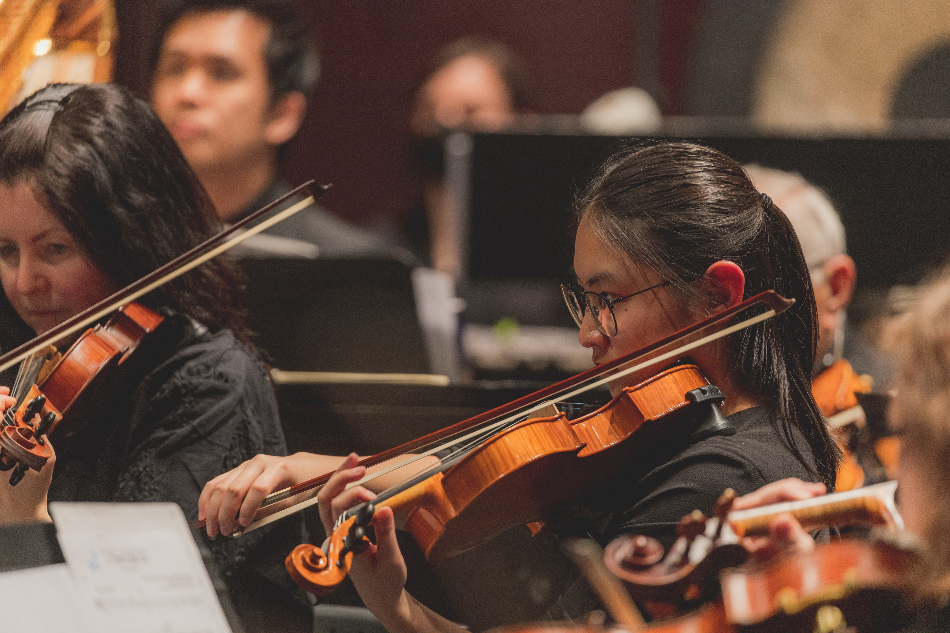
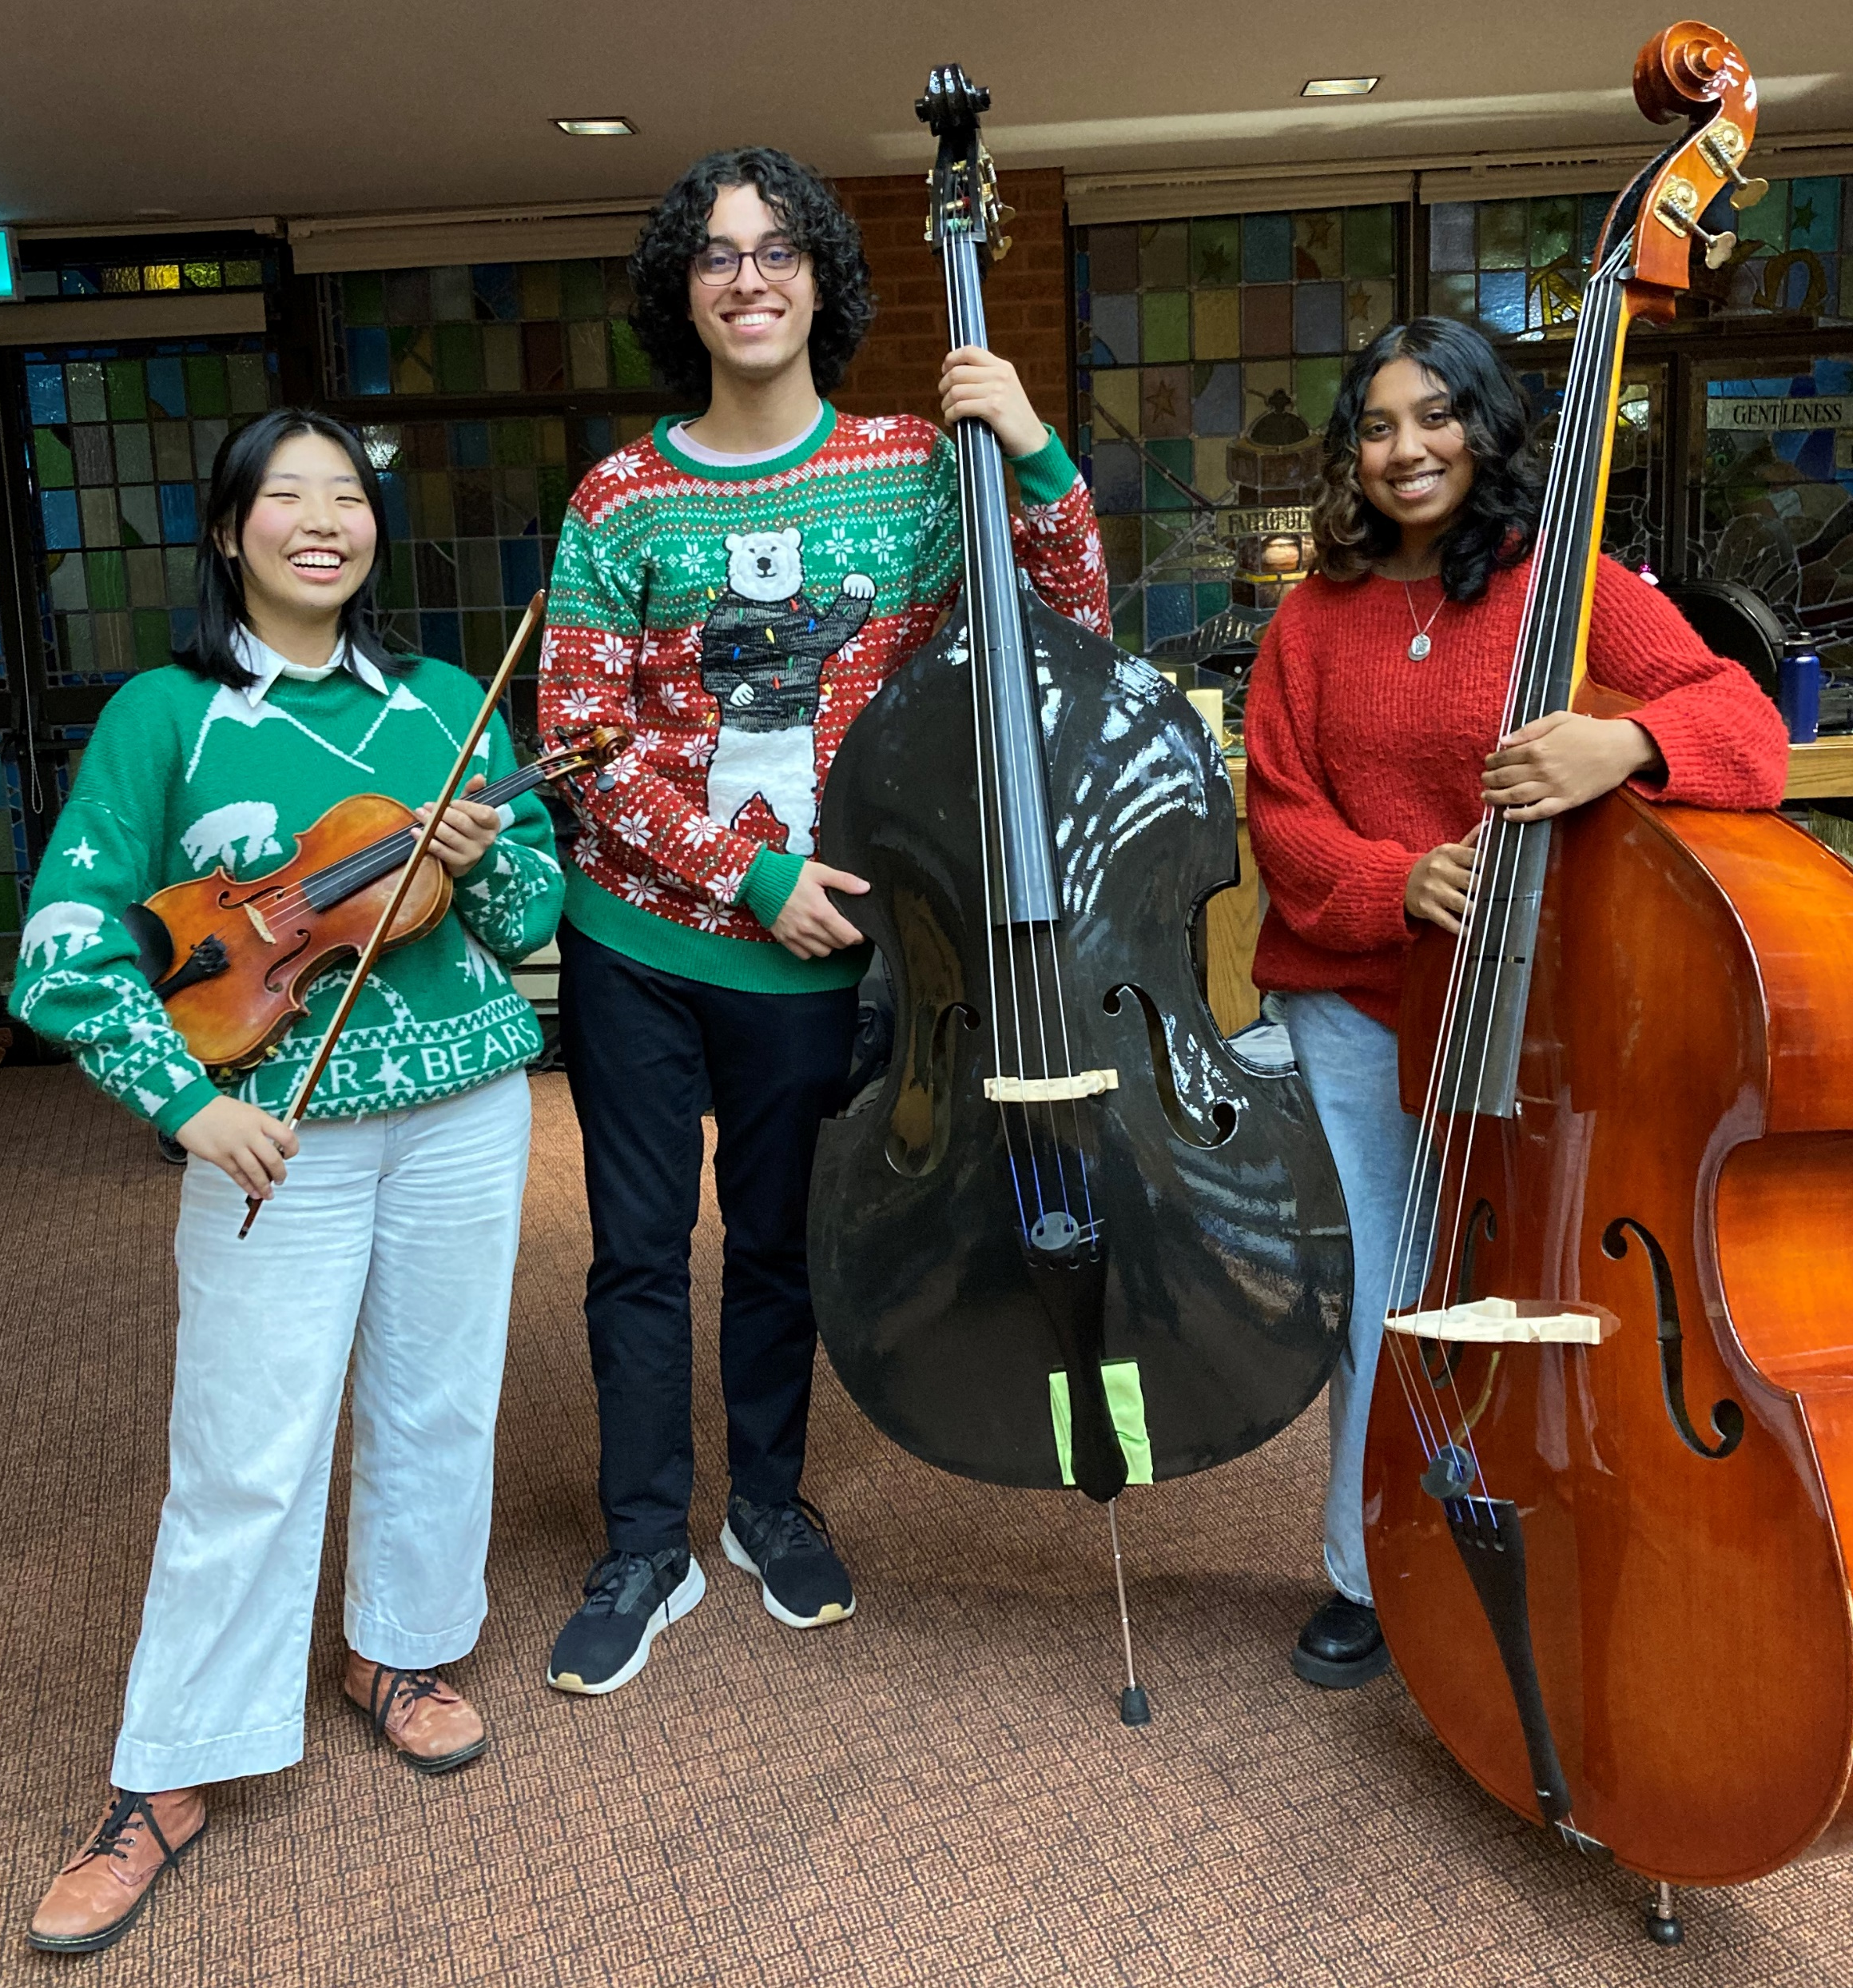
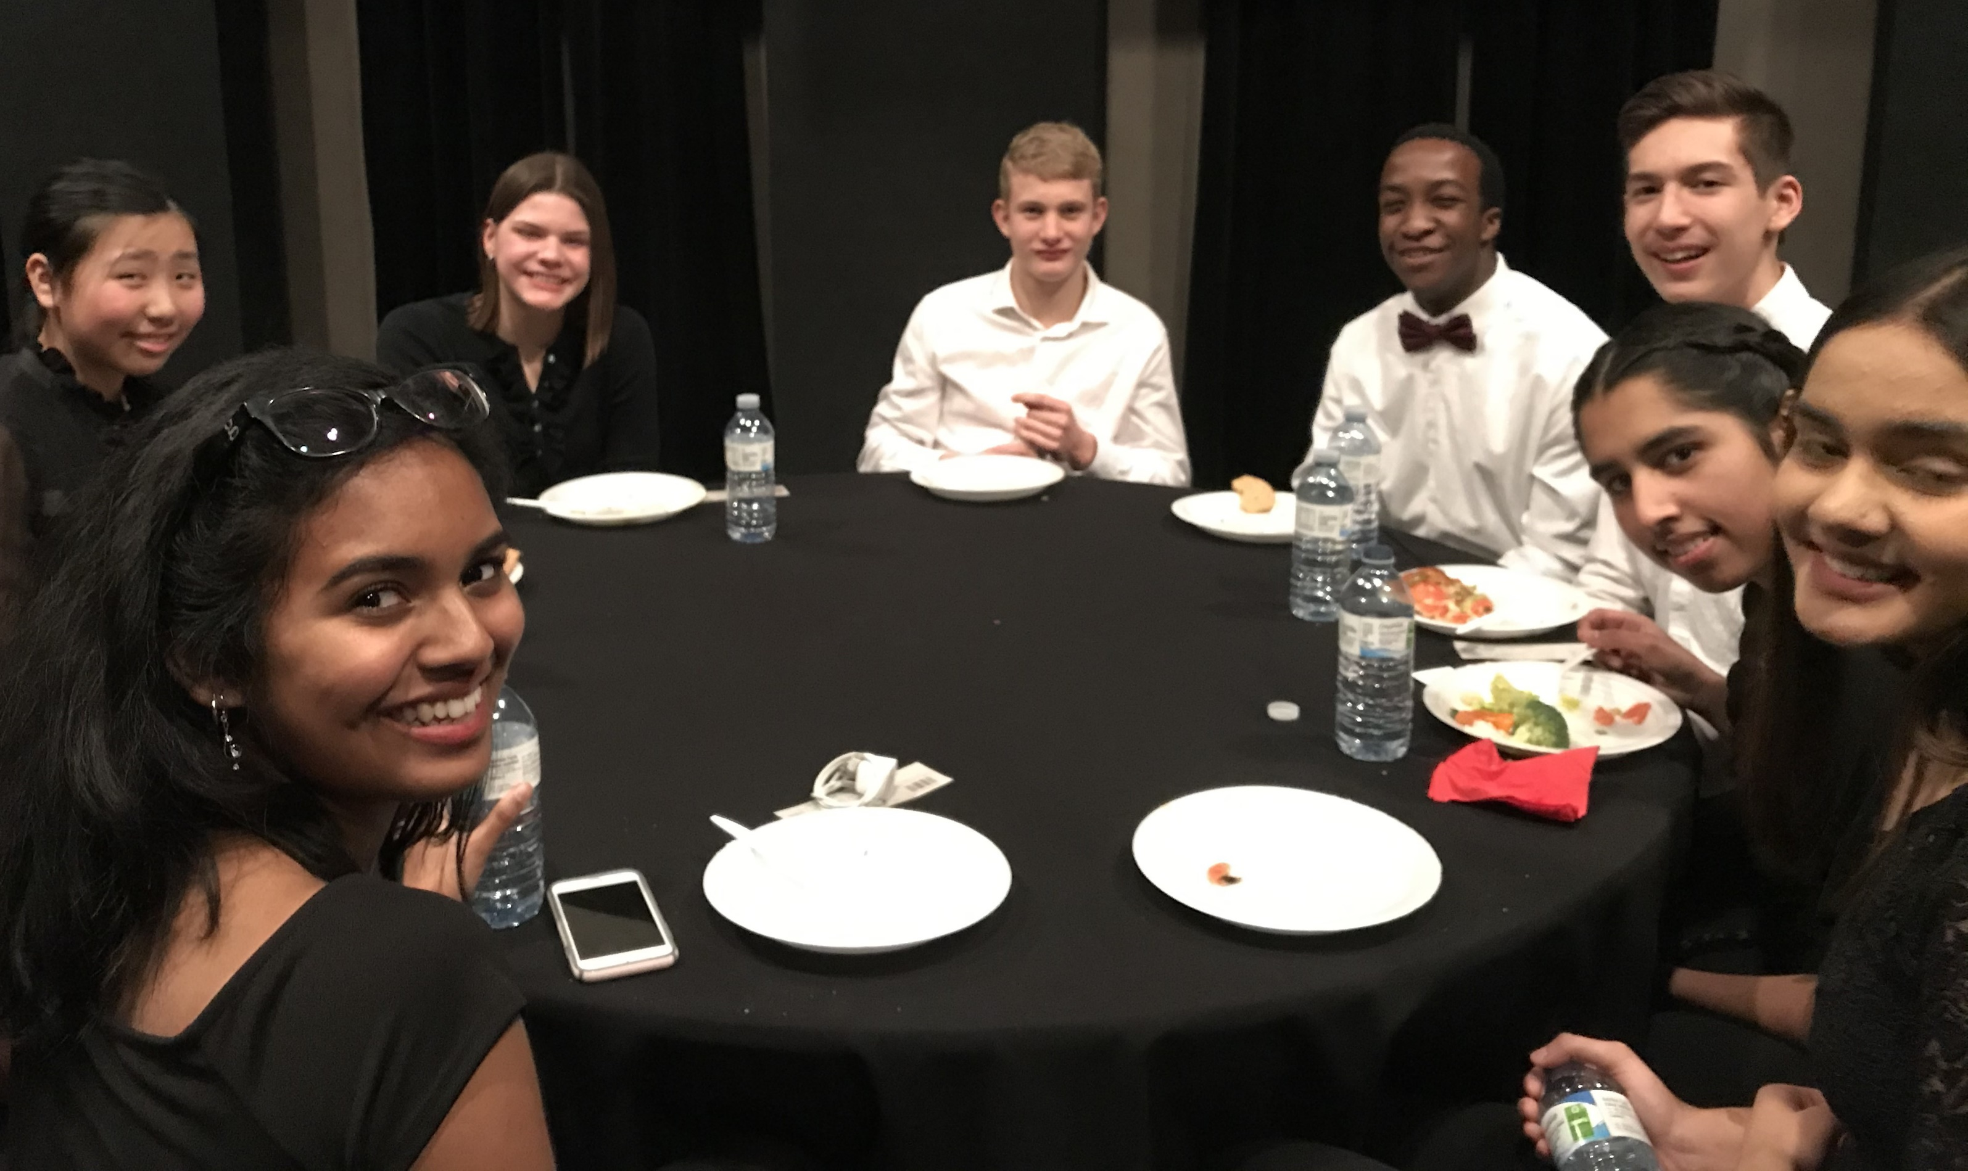
The Rosebud Orchestra
Notes:
An RB who has now graduated, is in univ, and still playing with us

Slide 7
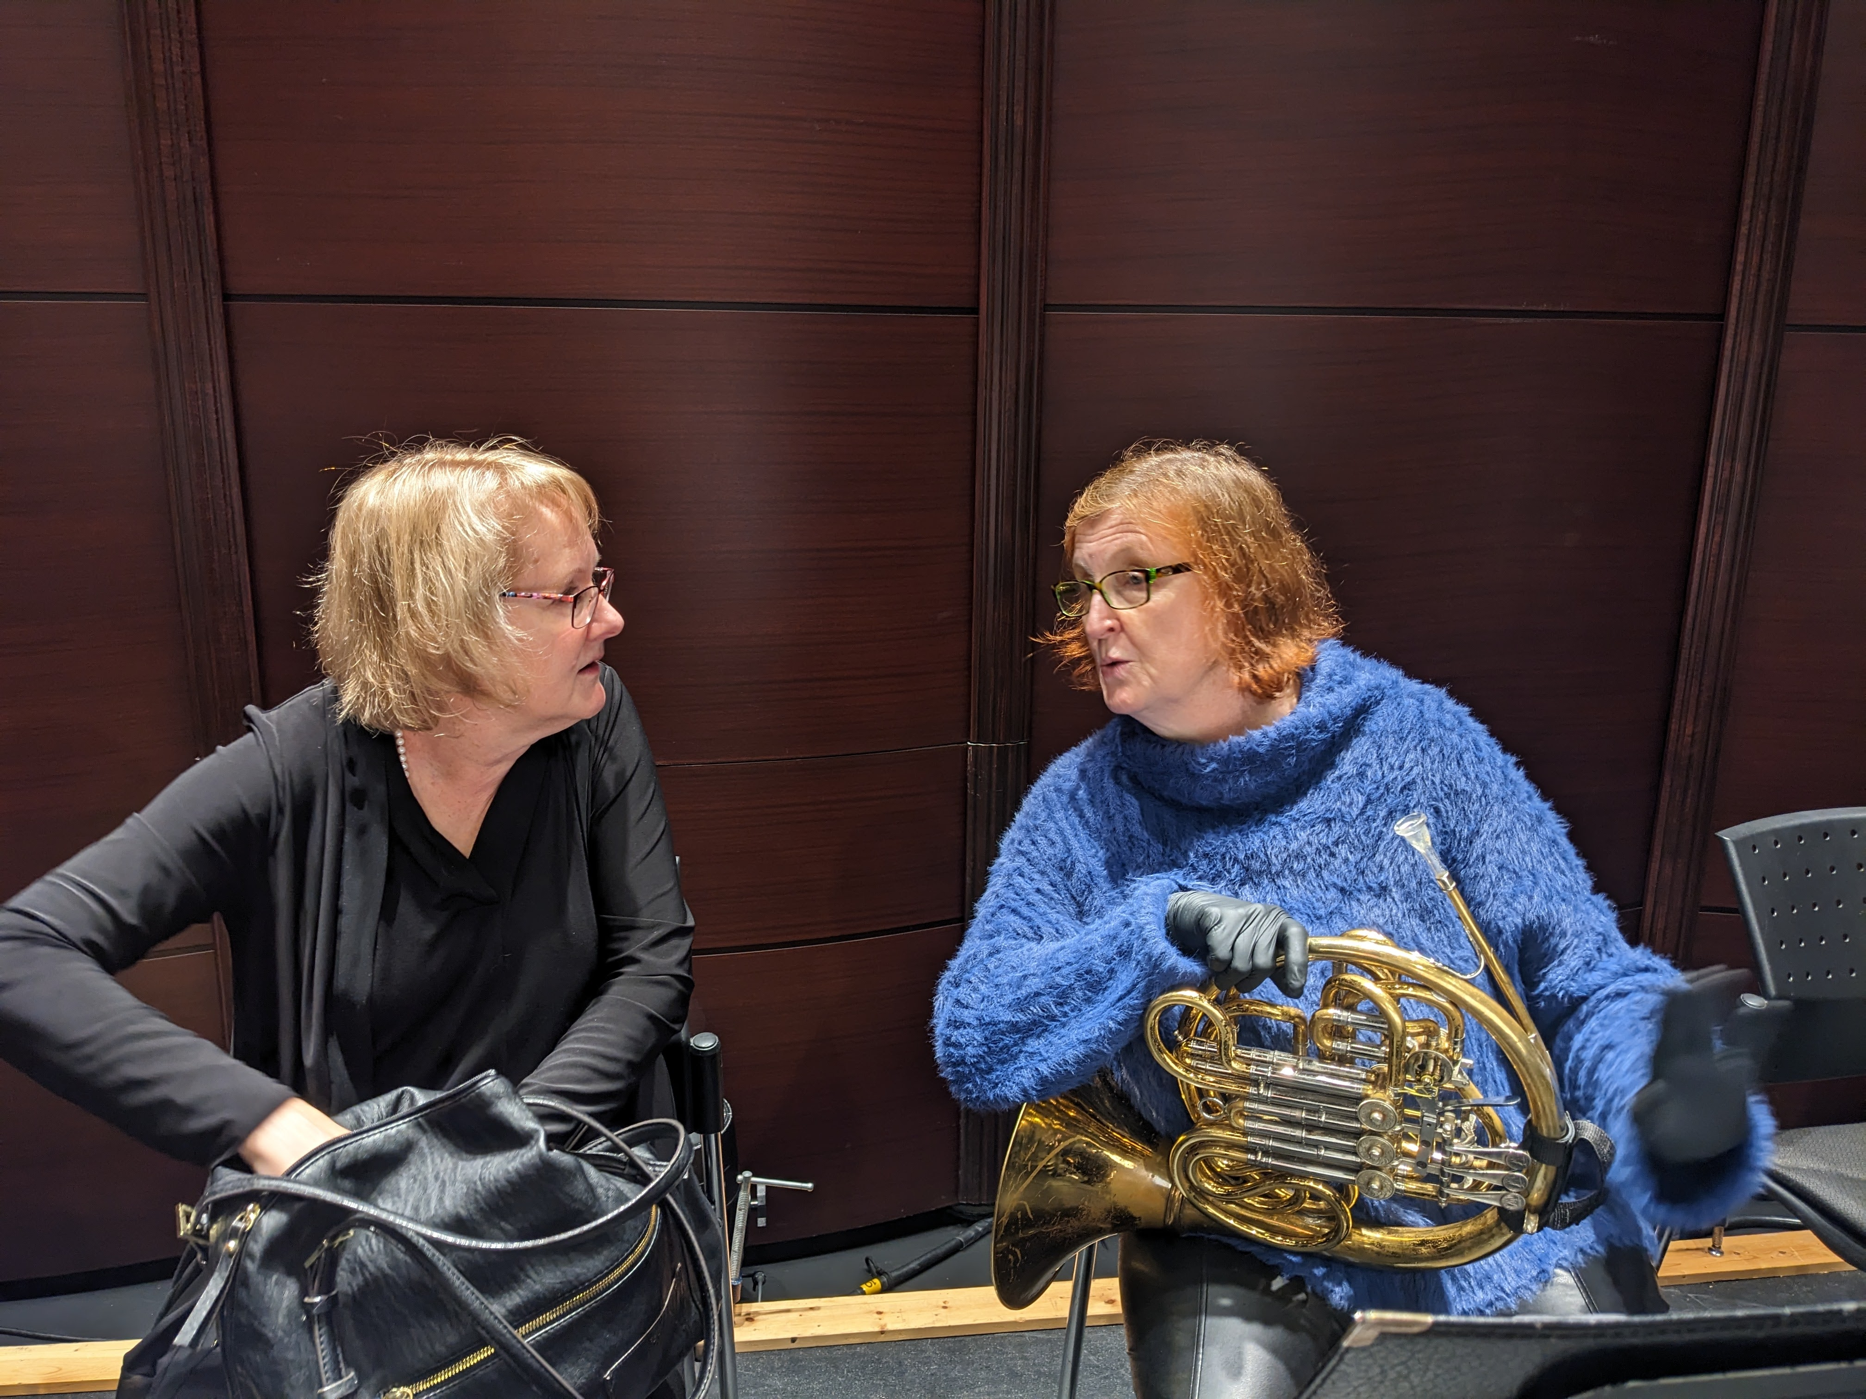
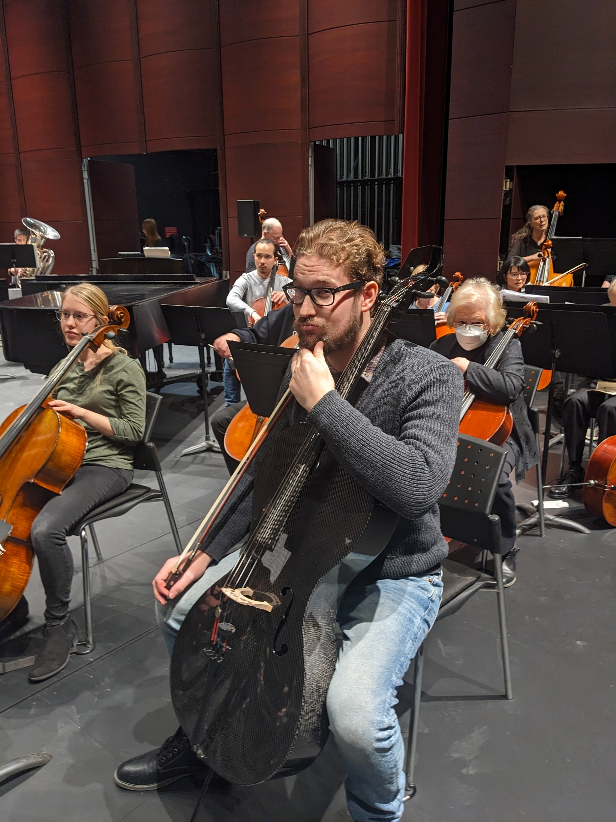
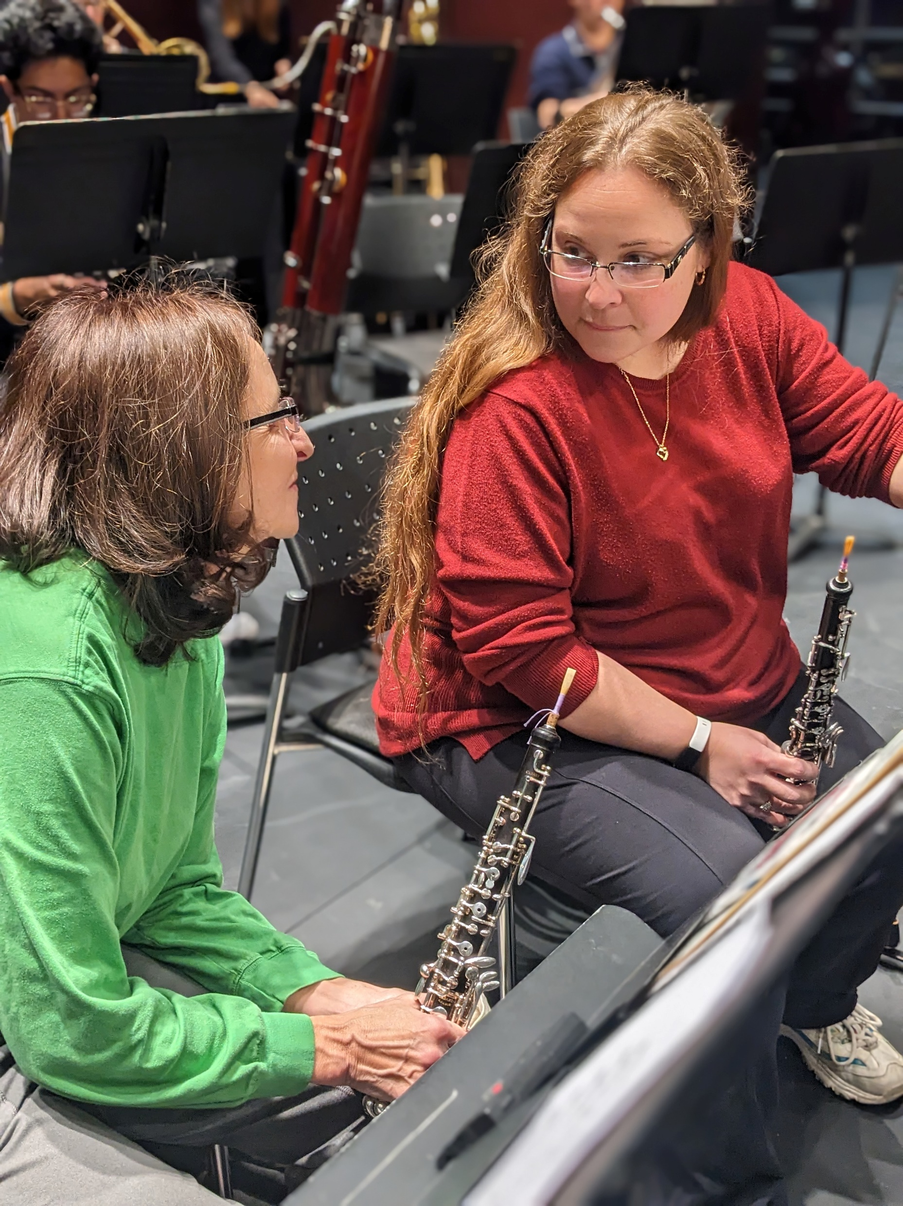
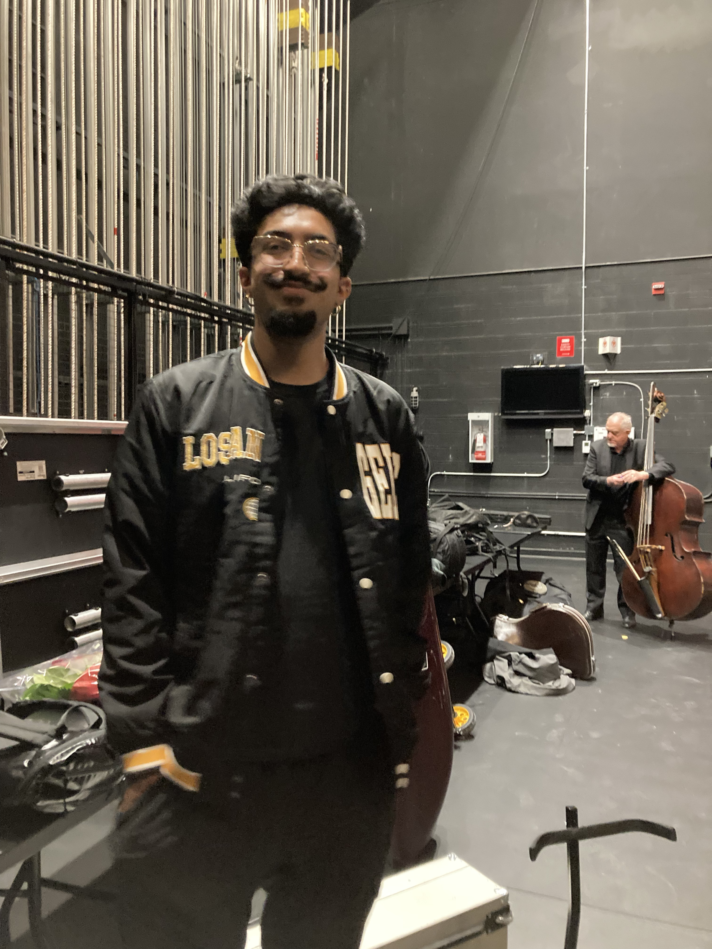
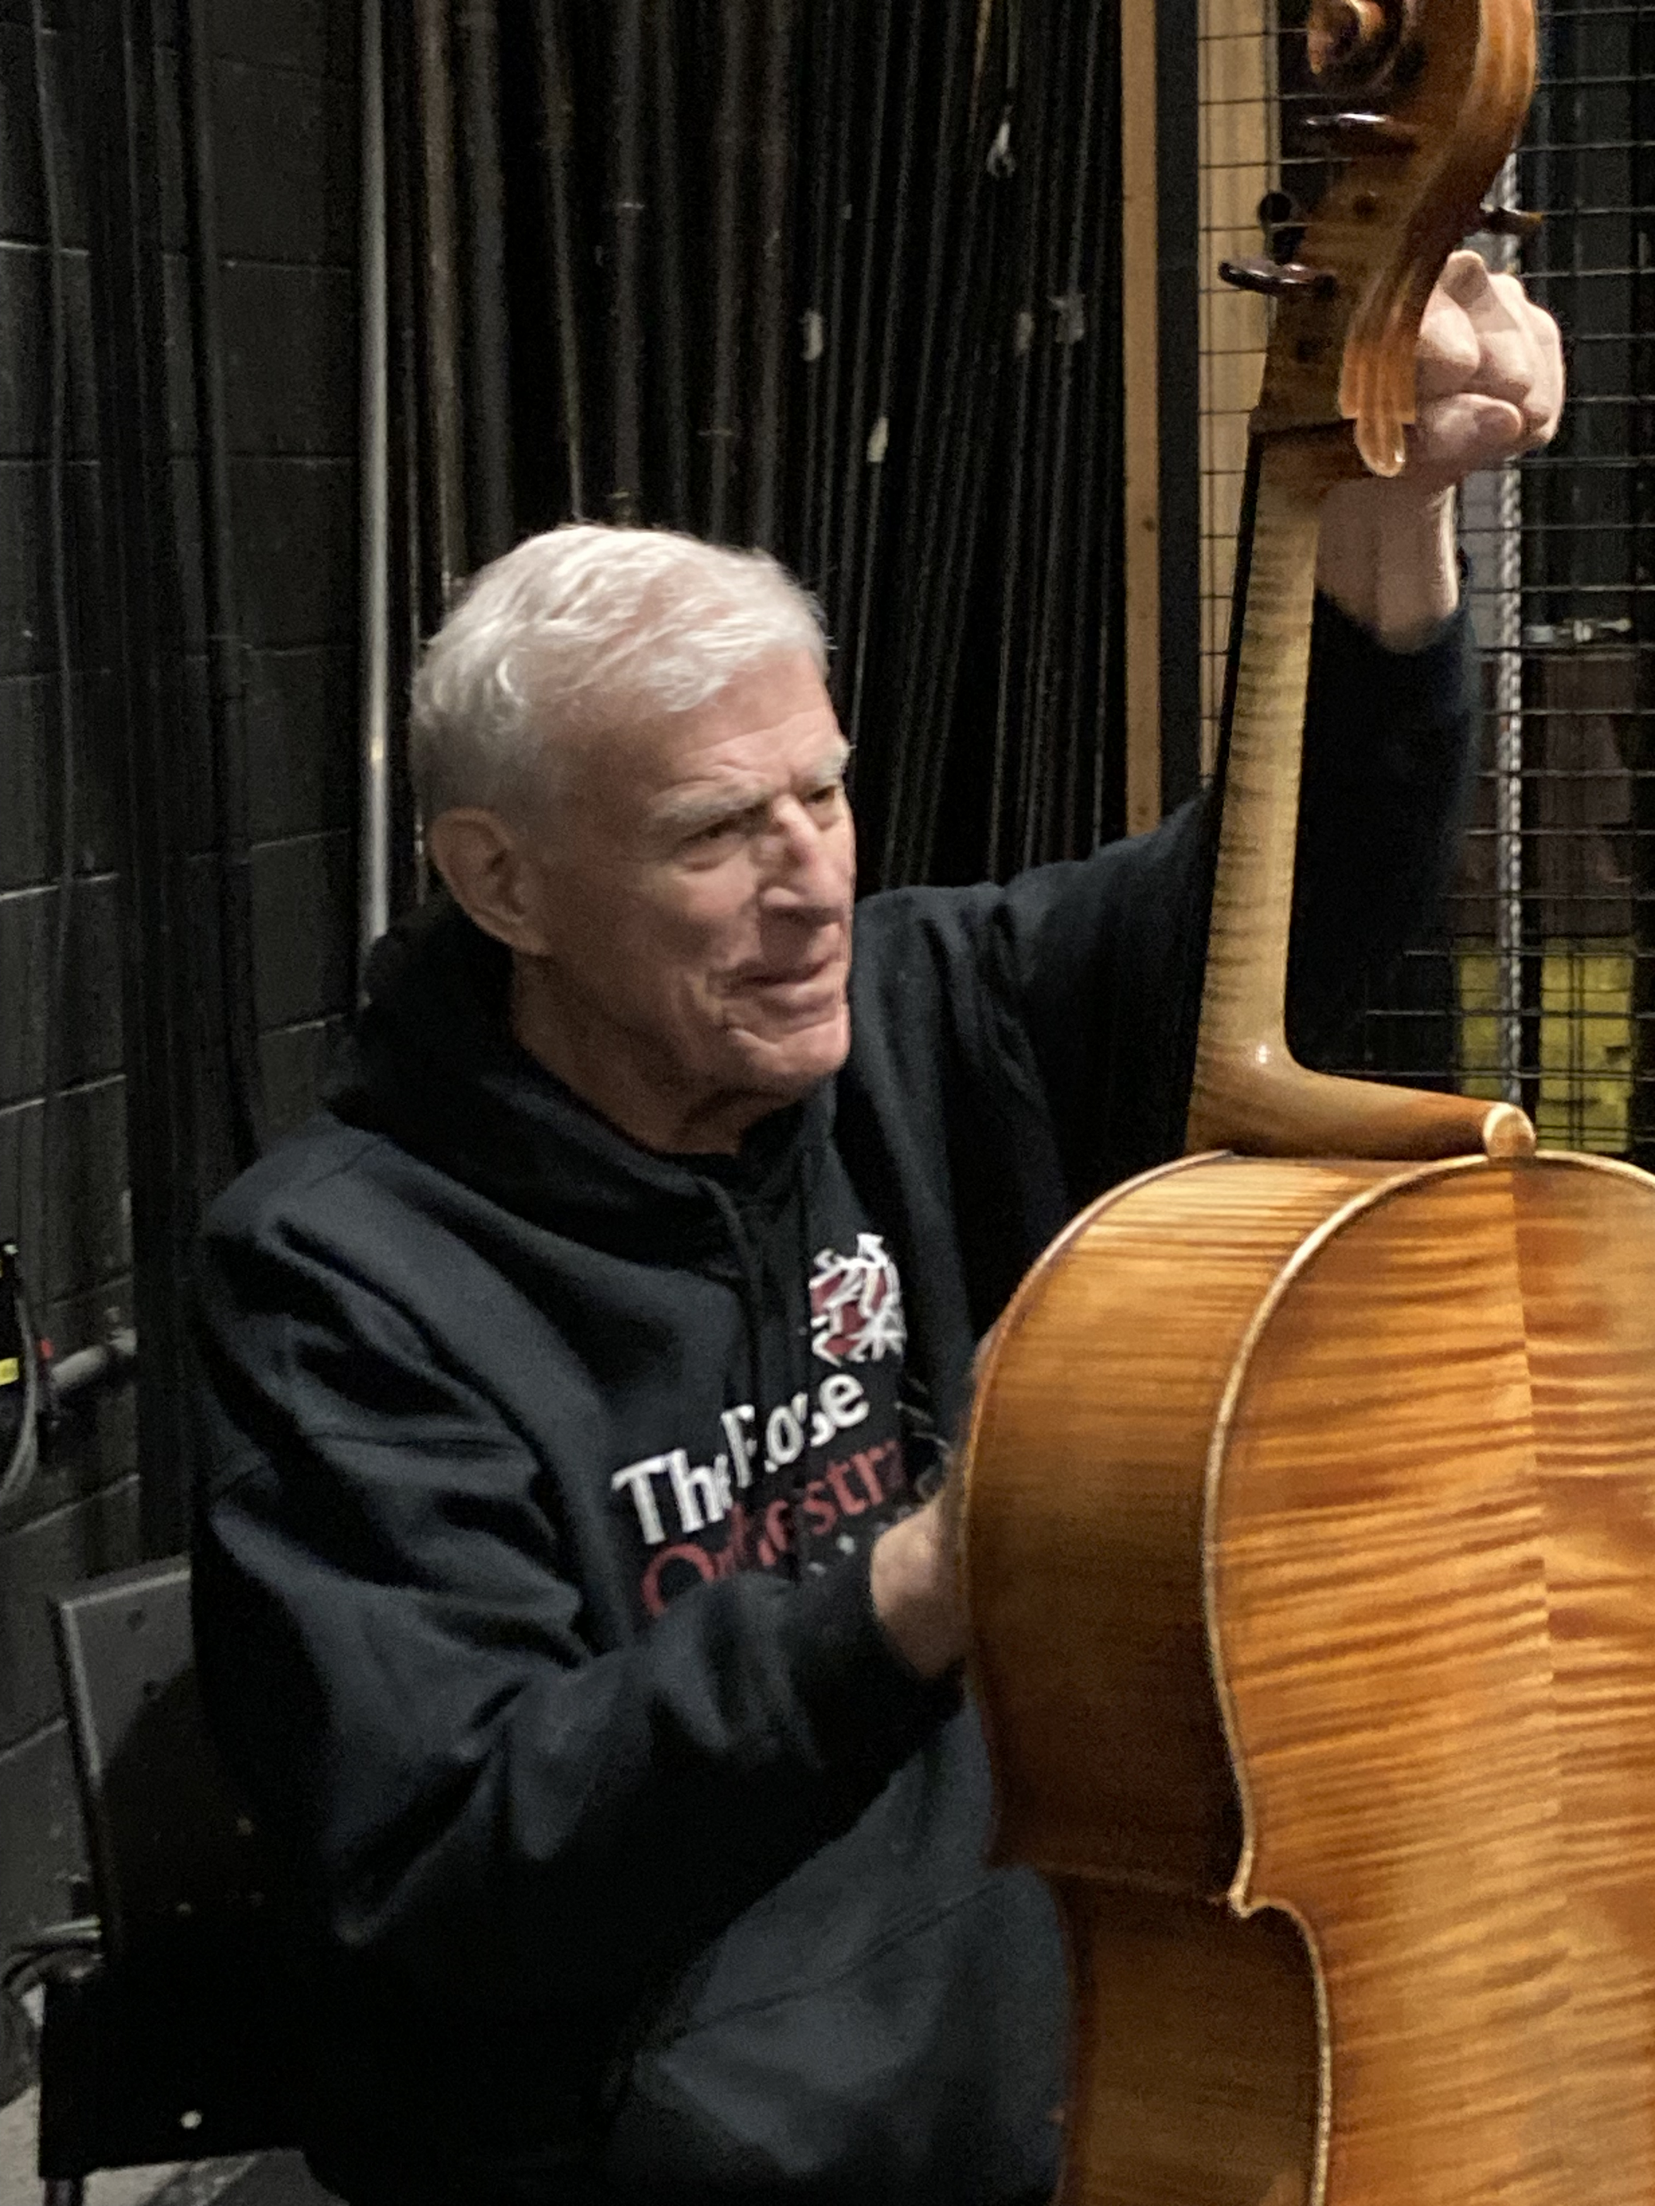
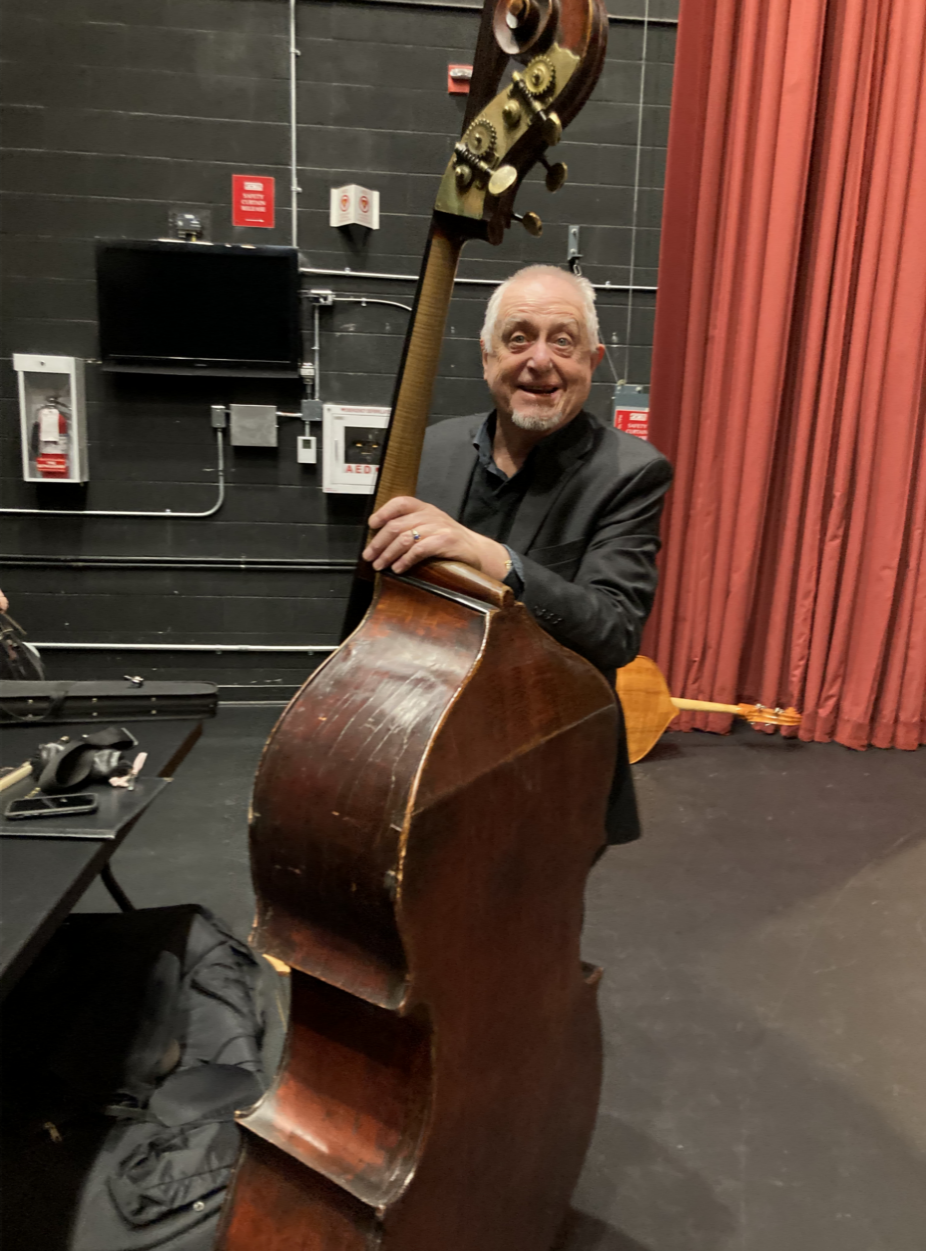
Behind the scenes
Notes:
You all know about this, but when musicians are not actually playing, they are just people, making jokes, supporting each other. Etc etc
Taran is now at u of t, still playing with us
Linds
Benjamin doctoral student at uof t

Slide 8
Notes:
Marian turns 100 this February
Opportunity to conduct
Womens theme

Slide 9
Upcoming Concerts
February 10, 2024 She Will Be Heard
March 23, 2024 Rakes, Rogues and Rascals
April 27, 2024 Strollin’ Into Summer
For tickets, contact the box office at The Rose Brampton
1 THEATRE LANE
BRAMPTON, ONTARIO L6V 0A3
BOX OFFICE: 905-874-2800
PERFORMINGARTS@BRAMPTON.CA
For information or to get in touch:
The Rose Orchestra
https://www.theroseorchestra.org/
info@theroseorchestra.org
Notes:
Marian turns 100 this February
Opportunity to conduct
Womens theme

